Slide 1
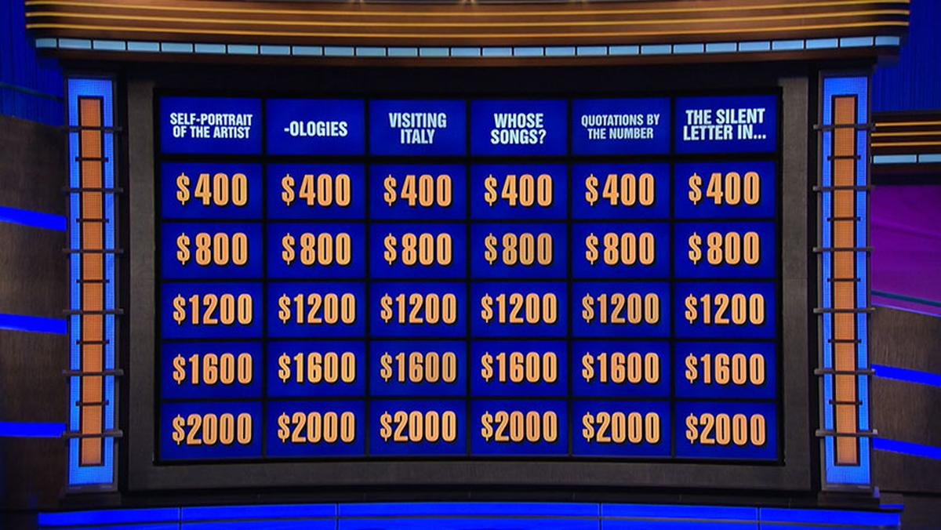
“Powers” that Be | Nothing beats “exp”-erience | Consumer “Products” | “Quotient” “Quot”-ables
$400 | $400 | $400 | $400
$800 | $800 | $800 | $800
$1200 | $1200 | $1200 | $1200
$1600 | $1600 | $1600 | $1600
$2000 | $2000 | $2000 | $2000

Slide 2

This function is the derivative of the polynomial
$$f\left(x\right)=5x^{2}−3x+2$$

Slide 3

This function is the derivative of the polynomial
$$g\left(x\right)=7x^{3}−6x^{9}+5x^{7}$$

Slide 4

This is the derivative of
$$y=\frac{6}{x}−\frac{5}{x^{2}}$$

Slide 5
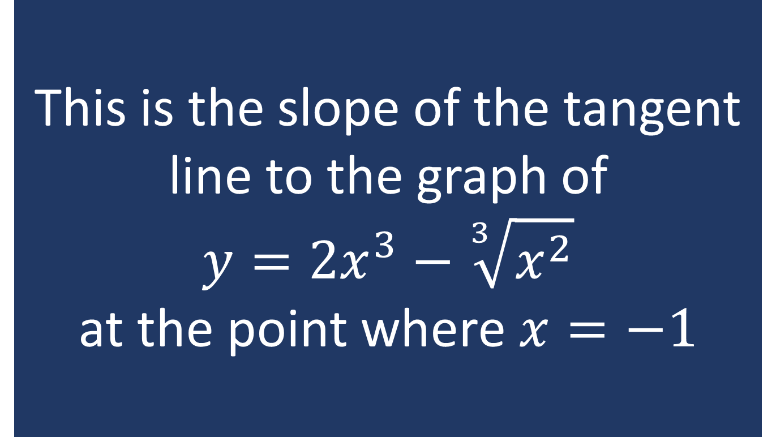
This is the slope of the tangent line to the graph of
$$y={2x}^{3}−\sqrt[3]{x^{2}}$$
at the point where $x=−1$

Slide 6

This is the slope of the line tangent to the graph of
$$y=\frac{5x−\sqrt{x}+4}{x^{2}}$$
at the point where $x=4$

Slide 7

This is the derivative of
$$f\left(x\right)=e^{x}+3$$

Slide 8

This is the derivative of
$$g\left(x\right)=5^{x}+k,$$
where $k$ is a constant

Slide 9

This is the derivative of
$$y=e∙3^{x}−2^{x}+1$$
at the point where $x=1$

Slide 10

This is the derivative of
$$f\left(x\right)=x^{4}+4^{x}$$

Slide 11
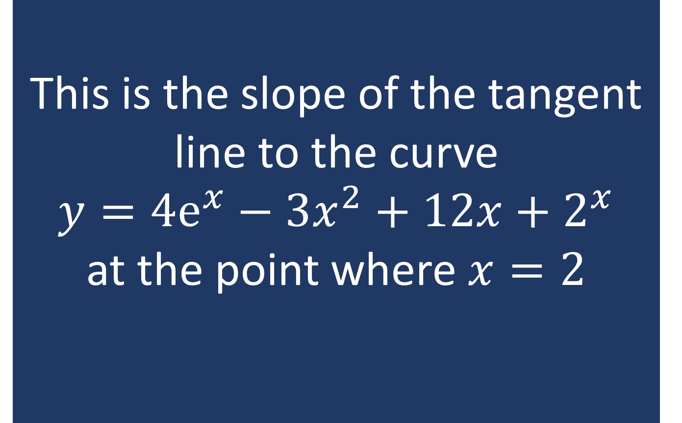
This is the slope of the tangent line to the curve
$$y=4ⅇ^{x}−3x^{2}+12x+2^{x}$$
at the point where $x=2$

Slide 12

This is the derivative of
$$f\left(x\right)=4x^{2}ⅇ^{x}$$

Slide 13

This is the derivative of
$$g\left(x\right)=7x^{5}⋅3^{x}$$

Slide 14

If we have $f\left(5\right)=−3$, $f^{′}\left(5\right)=$1, $g\left(5\right)=−2$, and $g^{′}\left(5\right)=−4$, then this would be $h′(5)$ if we know that $h\left(x\right)=f\left(x\right)g(x)$

Slide 15
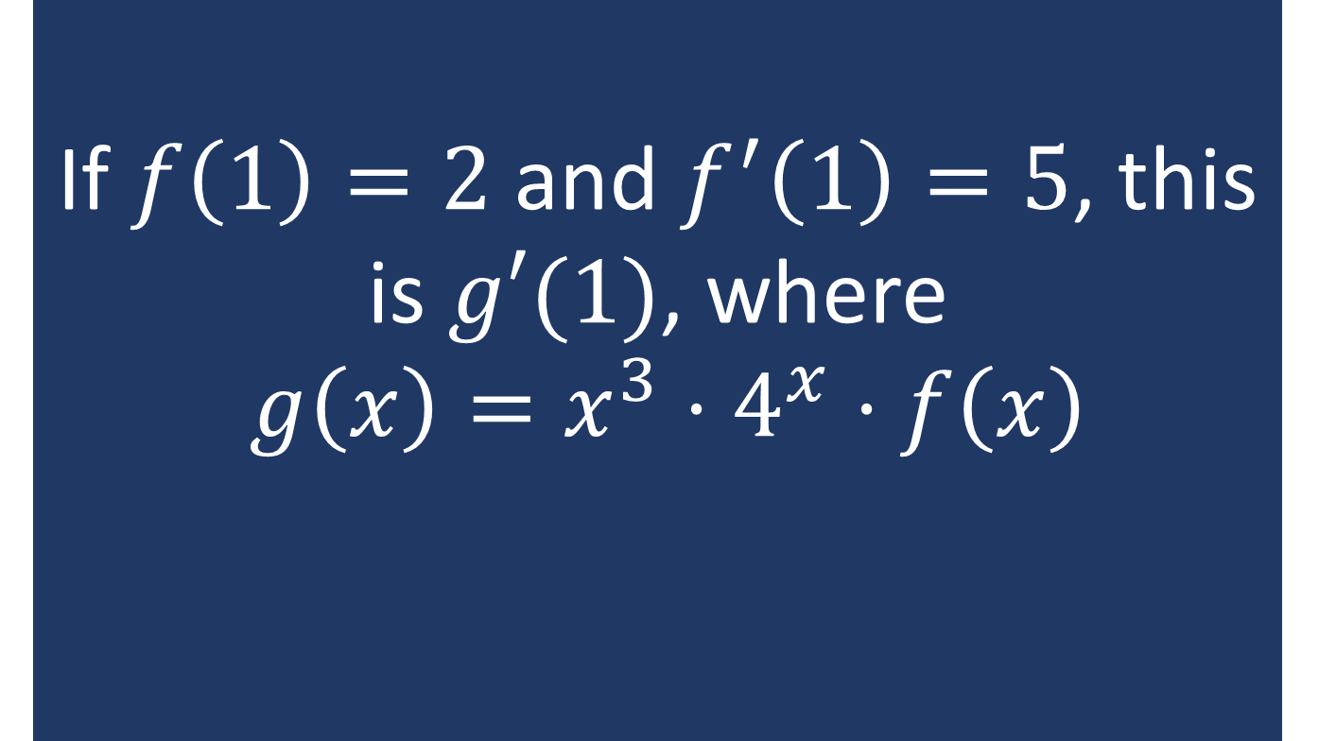
If $f\left(1\right)=2$ and $f^{′}\left(1\right)=5$, this is $g′(1)$, where
$g\left(x\right)=x^{3}⋅4^{x}⋅f\left(x\right)$

Slide 16

If $f\left(3\right)=−3$, $f^{′}\left(3\right)=4$, $g\left(3\right)=−2$, $g^{′}\left(3\right)=6,$
$h\left(3\right)=−6$, $h^{′}\left(3\right)=5$, and $p\left(x\right)=f\left(x\right)g\left(x\right)h\left(x\right)$, this is $p′(3)$.

Slide 17

This is the derivative of
$$f\left(x\right)=\frac{x}{2x+1}$$

Slide 18

This is the derivative of
$$g\left(x\right)=\frac{3x^{2}−4x}{5\sqrt{x}+2}$$

Slide 19

This is the derivative of
$$y=\frac{e^{x}−x^{2}}{\sqrt{x}+e^{x}}$$

Slide 20

This is the derivative of
$$s\left(t\right)=\frac{e^{t}−2^{t}}{t^{2}+3^{t}}$$

Slide 21
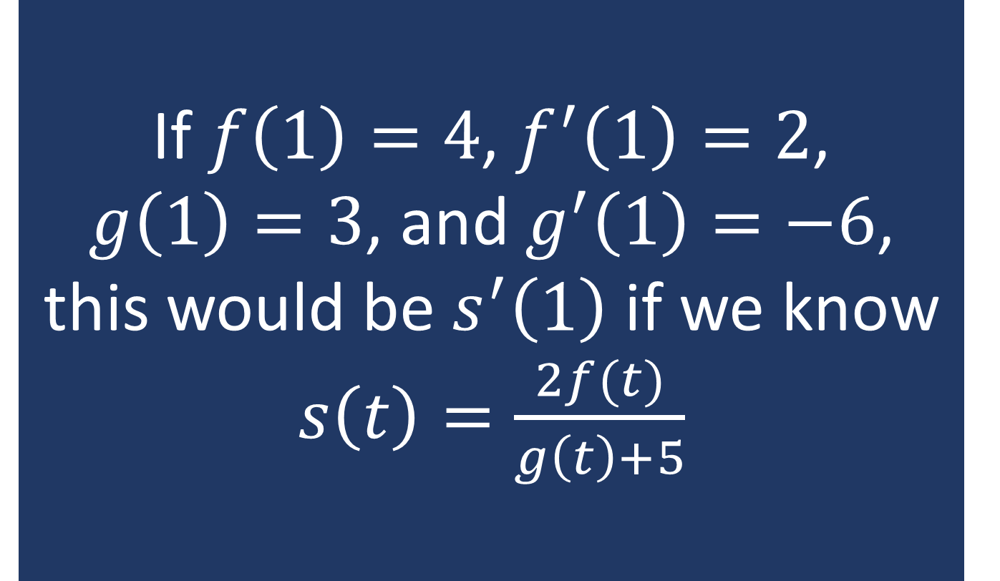
If $f\left(1\right)=4$, $f^{′}\left(1\right)=2$,
$g\left(1\right)=3$, and $g^{′}\left(1\right)=−6$, this would be $s^{′}\left(1\right)$ if we know $s\left(t\right)=\frac{2f(t)}{g\left(t\right)+5}$

